Slide 1

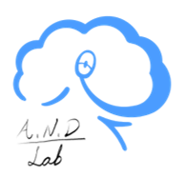
Social Cognition Chapter 6: Attribution Processes
Rain 2022.3.23

Slide 2
The main question:
How we find the underlying causal relationship of observed social behaviors and events?

Slide 3

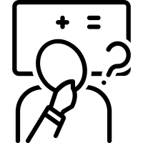

Components in social cognition
Social perception
Social inference
Social behaviors

Slide 4
Contents
Attribution aim to explain social experiences
Early attribution theories emphasized rational analysis
Several cognitive processes underlie attribution
Attribution are often biased

Slide 5
1.1 Causal Attributions
Attribution: how people infer causal explanation of the actions and mental states
Disposition: Thinking style, personality trait, hobbies, etc.
Causal reasoning connect limited number of domain-specific causes and particular cases.
Single sufficient explanation occurs quickly and virtually automatically, automatic process.
Dual-processing distinction
Unexpected or negative events induce an explicit causal reasoning

Slide 6
1.2 Basic principles of Causation
Causes precede effects
Temporal contiguity
Spatial contiguity
Perceptually salience
Causes – effects resemblance
Representative causes/ Avalability

Slide 7
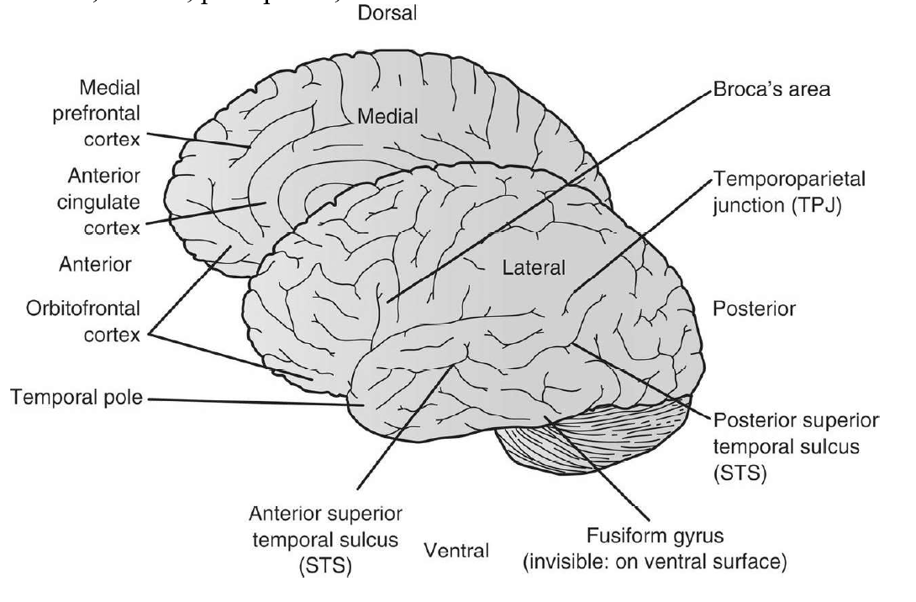
1.3 Dispositional attributions and mind perception

Slide 8
2. Early attribution theories emphasized rational analysis
Attribution analysis is initiated by people’s need to predict and control the future, which is fundamental for humans about knowing ‘why’.
Early attribution theories deal with more effortful cognitive process: social perceivers gather information, explain events, apply to other domains

Slide 9
Six theoretical traditions
Commonsense psychology
Correspondent inference
Covariance model
Emotional lability theory
Self-perception theory
Attributional theory
Generic, content free
Minimal determinism
Motivational point of departure

Slide 10
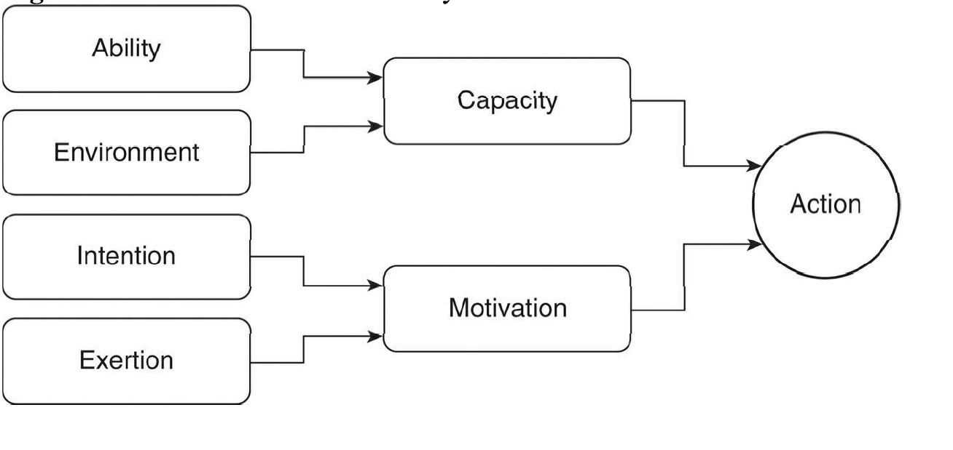
2.1 Commonsense psychology
How people think about and infer meaning from what occurs around them
How people extract dispositional properties based on observation of social behaviors
Invariance in the social environment
Personal causation:
ability & motivation
Impersonal causation:
contextual factors

Slide 11
2.2 Correspondent inference
Essentially concerns how we perceive other people: social perceivers aims to identify intentions underlying behavior with the purpose of inferring dispositions that will be robust across situations, and search for explanations that are stable and informative
Cues for inference:
(1) Social desirability (社会期许)
(2) Social role
(3) Noncommon (unique) effects

Slide 12
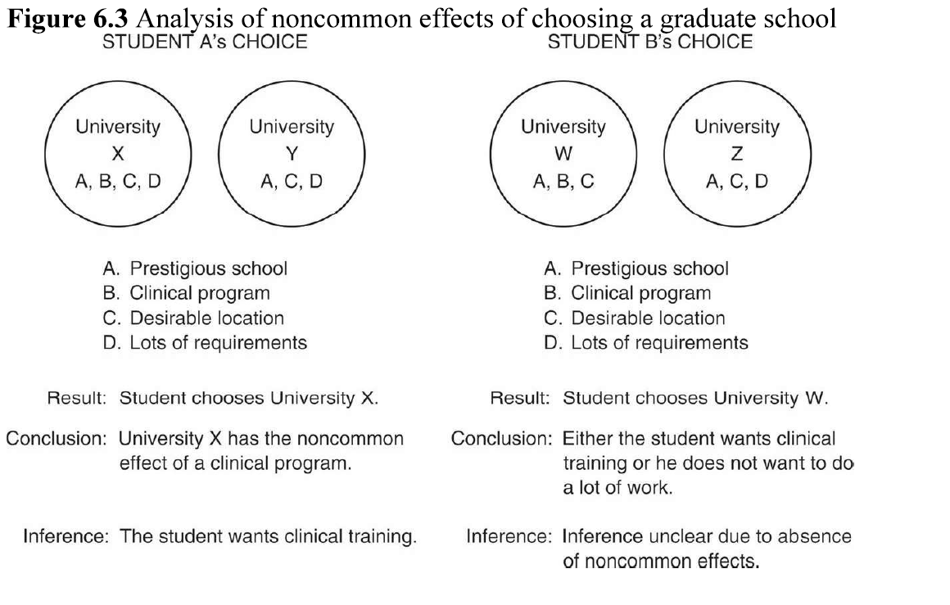

Slide 13

Hedonic relevance
Personalism
Situationally constrained
Personal involvement influence the attribution

Slide 14
2.3 Kelley’s Covariation models
Concerns when and how people seek to validate their causal attributions. And uncertainty prompts causal analysis
Distinctiveness: how unique the behavior to the given situation
Consistency over time/modality: Covariance of behavior across time
Consensus: Covariance of behavior across different people

Slide 15
Causal schemas
Multiple sufficient causal schemas
Discounting principle
Multiple necessary causal schemas
Augmenting principle
Causal Schema for Compensatory Causes

Slide 16
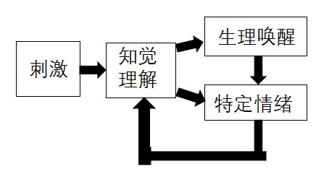
2.4 Emotional lability theory（情绪归因理论）
A theory that labeling arousal states
Attribution to mental states are malleable
Misattribution effects

Slide 17
2.5 Self-perception theory
People infer the attitudes of others by observing their own behavior
Self perception effects are stronger for behavior consistent with our preexisting attitudes
Intrinsic motivation
Extrinsic motivation

Slide 18
2.6 Weiner’s Attributional theory
Specific motivated behaviors: achievement and helping
Internal : Aptitude, Effort, Mood
Locus:
External: Objective task difficulty, luck, other uncontrollable factors
Stability: Aptitude & Objective task difficulty
Controllability: Effort

Slide 19
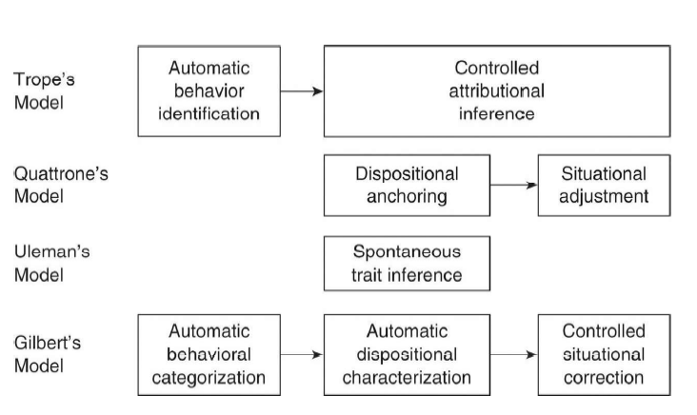
3. Cognitive processes underlie attribution
3.1 Stage models of attribution process

Slide 20
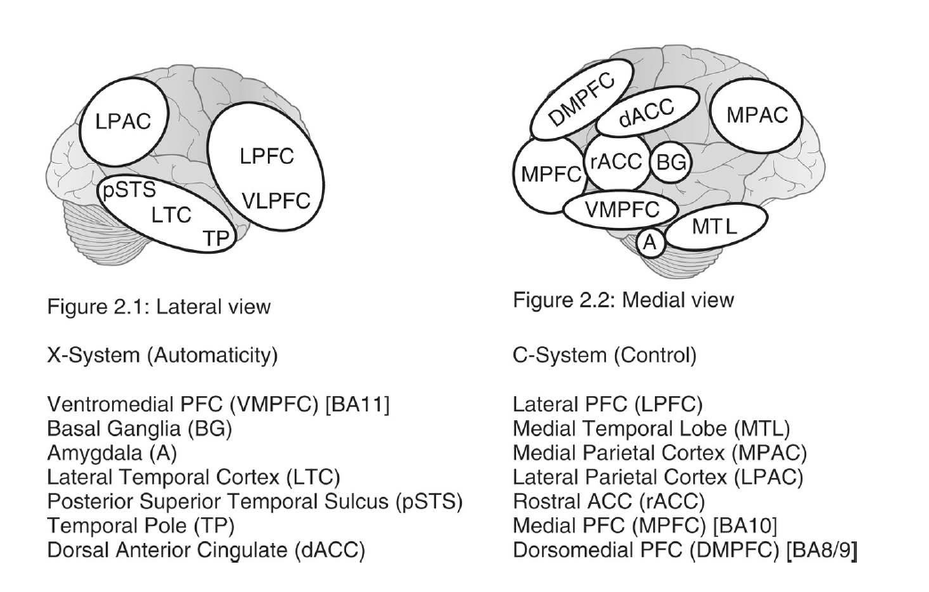
3.2 Neural bases of dispositional attributions

Slide 21
4. Attributions are often biased
4.1 Fundamental attribution error
(1) Overestimate another person’s behavior to dispositional causes, and underestimate the external factors
(2) The FAE depends on specific domain: e.g. friendly and honest behaviors
(3) Dispositional attributions for people’s behaviors increase when people in a good mood, but reduce when others have certain motivation
(4) Familiarity modulates dispositional attributions
(5) The cultural differences on FAE

Slide 22
4.2 The actor-observer effect
Explain others behavior based on dispositional attribution, but situational attributions for ourselves
4.3 Self-serving attributional bias/ Group-serving bias
Take credit for success and deny responsibility for failure
4.4 The self-centered bias
Take more credits for a joint contribution
4.5 Naïve realism
We attach greater credibility to our own introspections
4.6 Attributions of responsibility or blame
Especially for negative events, who or what that could foresee the situation should be attributed

Slide 23
Thanks for listening!

